Slide 1
BCOG 100
Brains and Reinforcement Learning
Lecture 1: The Computational Level

Slide 2
Reading Check 6-1
Password: reward
Question: How do classical and instrumental/operant conditioning relate to hebbian learning?

Slide 3
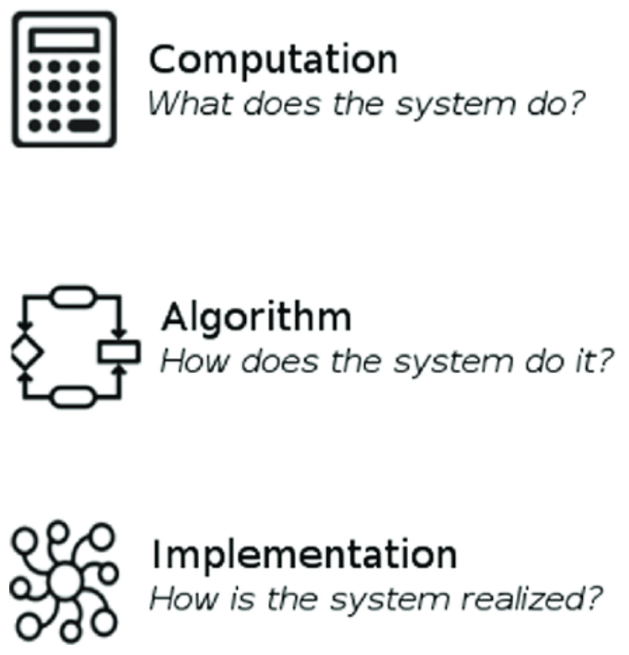
Brains and Reinforcement Learning
Recap & Overview
From circuits and Hebb to actions over time
Today:
What problem does reinforcement learning solve?
Why natural selection favored organisms that could do more than simple associations
Notes:
Last week we built from neurons to simple circuits and saw how Hebbian learning strengthens connections when things co-occur.
That gets us reflexes, associations, and even logic-like behaviors in circuits.
But co-occurrence is not the same as choosing actions that pay off later.
Real organisms have to select sequences of actions now to get outcomes that might arrive seconds or minutes later.
Today we’ll stay at the computational level and ask a clean question.
What is the problem reinforcement learning is trying to solve, stated without committing to any particular algorithm or brain area?
I want you to have an intuitive handle on why Hebbian association alone isn’t enough for survival once environments become competitive and dynamic.
By the end of this lecture, you should be able to state the RL problem in plain English and name the core challenges that any solution must overcome.
To keep our thinking organized we’ll use three complementary levels of analysis.
Computational asks what problem the system is solving and why that problem matters in its environment.
Algorithmic asks how the system could solve it in principle, in terms of internal representations and rules.
Implementational asks where and how it’s physically realized in the brain.
Today we are going to stick to the computational level of explanation.
We will define the problem that reinforcement learning solves, and the pressures that made its evolution beneficial.
In the next lecture we’ll move to algorithms, and in the third we’ll look at the brain circuits that implement them.

Slide 4
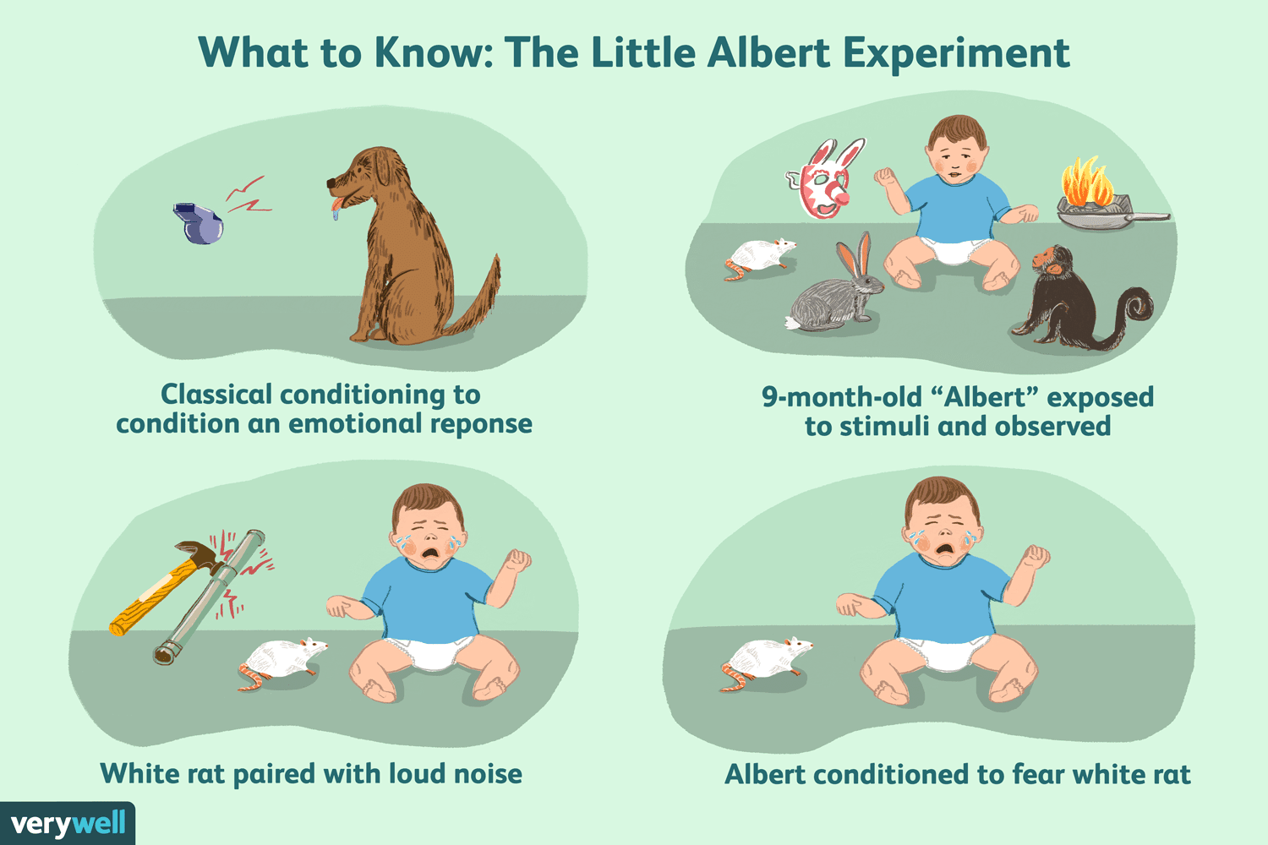
Brains and Reinforcement Learning
Why Hebb and Classical Conditioning Isn’t Enough
Hebbian Learning and Classical Conditioning = co-occurrence learning
Temporal credit assignment problem
Notes:
Hebbian learning works beautifully when two things happen close together.
If the taste of a food makes you sick, Hebbian association quickly ties that taste to an avoidance response.
If a tone comes half a second before a shock,
neurons for the tone and for the shock fire together and strengthen their connection,
so the tone becomes a cue for fear.
But many real-world situations don’t line up this neatly in time.
Imagine a warning light turns on, and only five seconds later comes the shock if you don’t move.
The neurons for the light and the neurons for the shock are too far apart in time for simple Hebbian learning to connect them.
Yet animals like fish and mammals can learn to move at the warning light to avoid the shock.
This is the temporal credit assignment problem.
Hebb can shape associations with immediate consequences,
but it cannot easily assign credit to actions or cues that are distant from their outcomes.
Reinforcement learning mechanisms evolved to bridge this gap,
letting organisms learn that something that happens now may matter much later.

Slide 5
Brains and Reinforcement Learning
525 MYA
Bilaterians
4 BYA
Origin
of
Life
2 BYA
Complex
Eukaryotes
1.4 BYA
Multi-
cellular
Life
2025
500 MYA
Cambrian
Explosion
2.4 BYA
Great
Oxygenation
Event
Cambrian Explosion
Hebbian Learning and Classical Conditioning = co-occurrence learning
Temporal credit assignment problem
650 MYA
Early
Complex
Animals
The Cambrian Explosion
540–485 million years ago
Rapid diversification of animal life
Predator–prey arms race drives complexity
Notes:
About 540 million years ago we reach one of the most famous turning points in evolutionary history:
the Cambrian explosion.
In the span of just a few tens of millions of years,
Earth’s oceans went from relatively simple ecosystems to an extraordinary burst of animal diversity.
Before this period, life was dominated by soft-bodied,
slow-moving organisms like those of the Ediacaran fauna.
In the Cambrian, new predators evolved—
arthropods with shells, claws, and powerful mobility.
That kicked off an arms race:
prey needed new defenses, and predators needed sharper strategies to catch them.
Brains and nervous systems were critical tools in this new era.
Organisms could no longer rely only on reflexive associations.
They had to adapt to fast-changing, dangerous environments
by trying new behaviors and learning which ones worked.
The Cambrian explosion thus set the stage for reinforcement learning.
It created the pressures that favored animals able to
connect actions with delayed consequences—
an ability that Hebbian association alone could not provide.

Slide 6
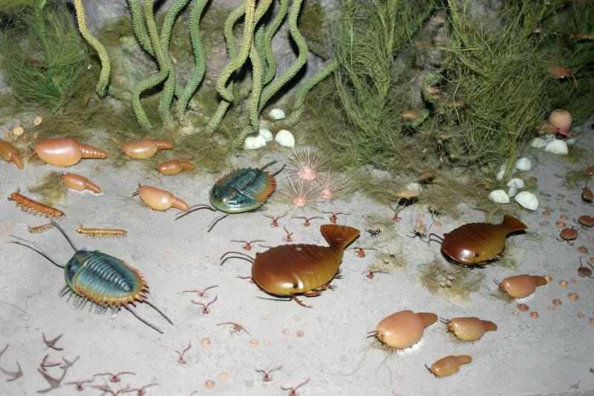
Brains and Reinforcement Learning
Brains Before Reinforcement Learning
Early bilaterians: simple circuits
Valence and steering mechanisms
Reflexes, but limited flexibility
Notes:
Before reinforcement learning emerged, early bilaterians already had simple nervous systems.
They could steer toward things that were good, like nutrients,
and away from things that were bad, like noxious chemicals.
These systems combined sensory input with valence —
positive or negative signals — to guide reflexive behaviors.
Essentially, they had steering circuits and hardwired reflexes that let them survive in relatively simple environments.
But what they lacked was flexibility.
They could not easily discover new sequences of actions to reach goals,
or avoid threats in novel ways.
Their brains were adapted for immediate reactions,
not for connecting present actions with delayed consequences.
This is the backdrop: reflexes and Hebbian associations existed, but reinforcement learning was still missing.

Slide 7
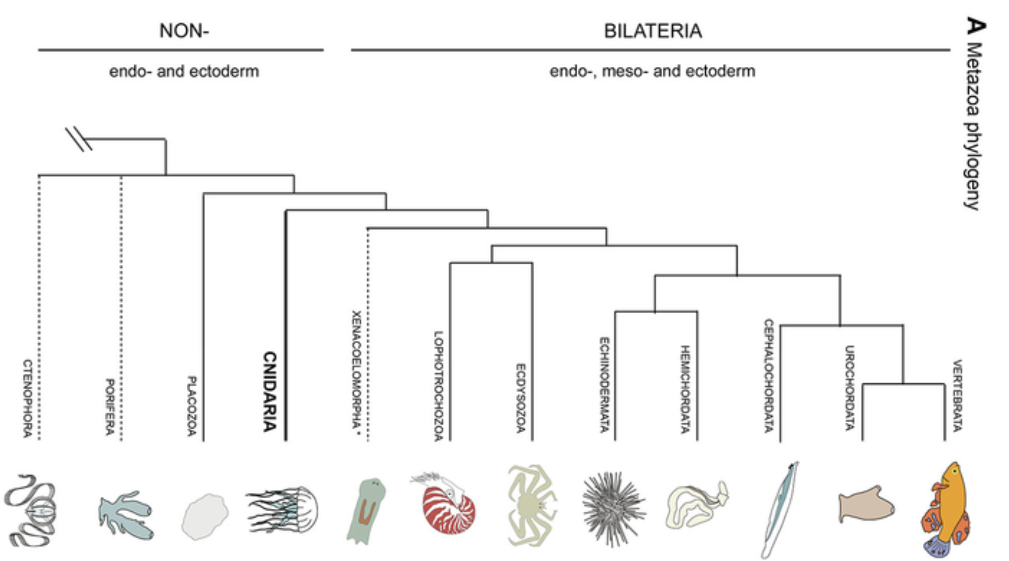
Brains and Reinforcement Learning
Early Vertebrates Appear
Big split: vertebrates vs invertebrates
Arthropods dominate, but lack spinal cords
Chordates: from sea squirts to fish
Notes:
One of the most important splits in the Cambrian was between the invertebrates and the vertebrates.
On the invertebrate side, arthropods became the dominant group.
They had hard exoskeletons, jointed legs, and nervous systems built around ganglia and ventral nerve cords.
Arthropods thrived in this new world, but their brains followed a very different path from ours.
On the vertebrate side, a new innovation appeared: the spinal cord enclosed in a backbone.
This opened the door to larger,
more complex nervous systems and the first recognizable brains
with forebrain, midbrain, and hindbrain divisions.
All vertebrates are chordates, but not all chordates are vertebrates.
One example is the tunicate, or sea squirt.
As larvae, sea squirts have tails, a notochord,
and a small brainlike structure that lets them swim around.
But once they settle onto a rock, they digest much of their nervous system —
they literally eat their own brain, because as filter feeders, they don’t need it anymore.
Another non-vertebrate chordate is the lancelet,
which keeps a notochord and a simple nerve cord through its whole life.
Together, these cousins show what the earliest steps toward vertebrates looked like.
Our ancestors were the vertebrate chordates —
small, fishlike animals with fins, gills, spinal cords, and the first complex brains.
This branch gave rise to the template of brain structures that persists across all vertebrates today.

Slide 8

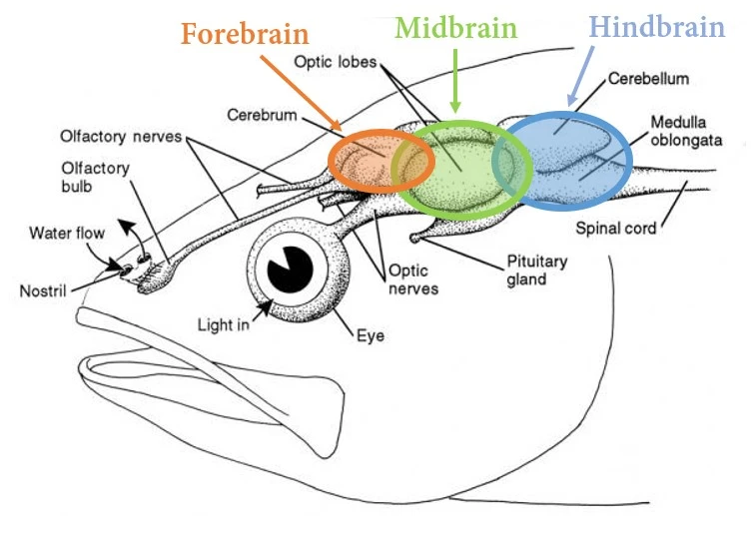
Brains and Reinforcement Learning
Vertebrate Brain Template
Shared plan across all vertebrates
Forebrain, midbrain, hindbrain
Basis for complex learning
Notes:
When we look inside the head of those early vertebrate fish, we see a pattern that is still with us today.
All vertebrates, from lampreys to humans, share a common brain template.
At the broadest level, the brain develops into three main regions: a forebrain, a midbrain, and a hindbrain.
The forebrain then further subdivides,
giving rise to the cortex and basal ganglia on one side,
and the thalamus and hypothalamus on the other.
This template is remarkably conserved.
A lamprey fish has basal ganglia, thalamus, hypothalamus, midbrain, and hindbrain
that are directly comparable to those in our own brains.
The only part that really scales up in mammals is the cortex.
The vertebrate brain template provided the structural foundation for more flexible forms of learning.
With this architecture in place, animals could move
beyond reflexes and associations toward trial-and-error reinforcement learning.

Slide 9
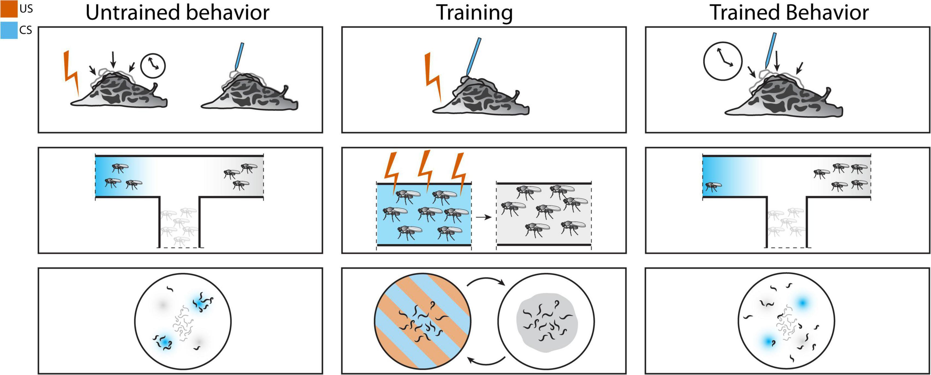
Brains and Reinforcement Learning
Simple Trial-and-Error Hebb Can Handle
Immediate cause and effect
Stimuli paired closely in time
Associations guide reflexive responses
Notes:
We’ve just seen that early vertebrates introduced a new brain template with forebrain, midbrain, and hindbrain.
So what did this new brain actually do?
At first, many of the problems it solved were the same kinds of problems earlier animals had faced.
It could handle simple trial-and-error through Hebbian association,
where causes and effects were right next to each other in time.
Touch something hot and feel pain right away.
Taste something bitter and feel nausea almost immediately.
Hear a sound that reliably predicts a shock a moment later.
In all these cases, neurons for the cue and neurons for the outcome fire together,
and the association is stamped in.
This kind of learning was possible with simpler nervous systems
— and vertebrates inherited it.
But their bigger brains opened the door to harder problems,
where Hebbian learning alone would not be enough.

Slide 10

Brains and Reinforcement Learning
Trial-and-Error With Delayed Rewards
Actions separated from outcomes
Sequences must be linked across time
Simple association is not enough
Notes:
With a larger and more structured brain, vertebrates could now tackle a harder class of problems.
These are trial-and-error situations where the outcome comes well after the action that caused it.
Think about cooking a new recipe.
You take many steps, and only at the end do you find out if the meal tastes good.
Or studying for an exam.
You put in effort over days or weeks, and only later do you receive the grade that tells you if it paid off.
Or practicing a sport.
Small improvements add up, but the payoff may come many games later.
Here, Hebbian learning falls short.
The actions and their consequences are separated in time,
so the neurons don’t fire together closely enough to form a simple association.
To solve these problems, animals need a way to connect distant causes and effects.
This is the gap that reinforcement learning fills.

Slide 11
Brains and Reinforcement Learning
What a Reinforcement-Learning System Must Do
Connect actions to delayed outcomes
Work across seconds, minutes, longer
Balance immediate vs future rewards
Notes:
So with vertebrate brains came the capacity to handle problems Hebbian learning couldn’t touch.
Reinforcement learning is the mechanism that bridges the gap between present actions and delayed outcomes.
It has to link behavior now to consequences that may not appear until much later.
Sometimes the delay is just a few seconds, like a warning light followed by a shock.
Other times it can be hours, days, or even longer, as in studying, practicing, or saving food.
And reinforcement learning also has to handle a second challenge:
deciding whether to grab a smaller reward now or wait for a bigger one later.
This trade-off between immediate and future rewards is a universal feature of animal behavior.
In short, reinforcement learning must connect distant actions to outcomes,
scale across different time delays, and guide choices about when to act for the best long-term payoff.

Slide 12
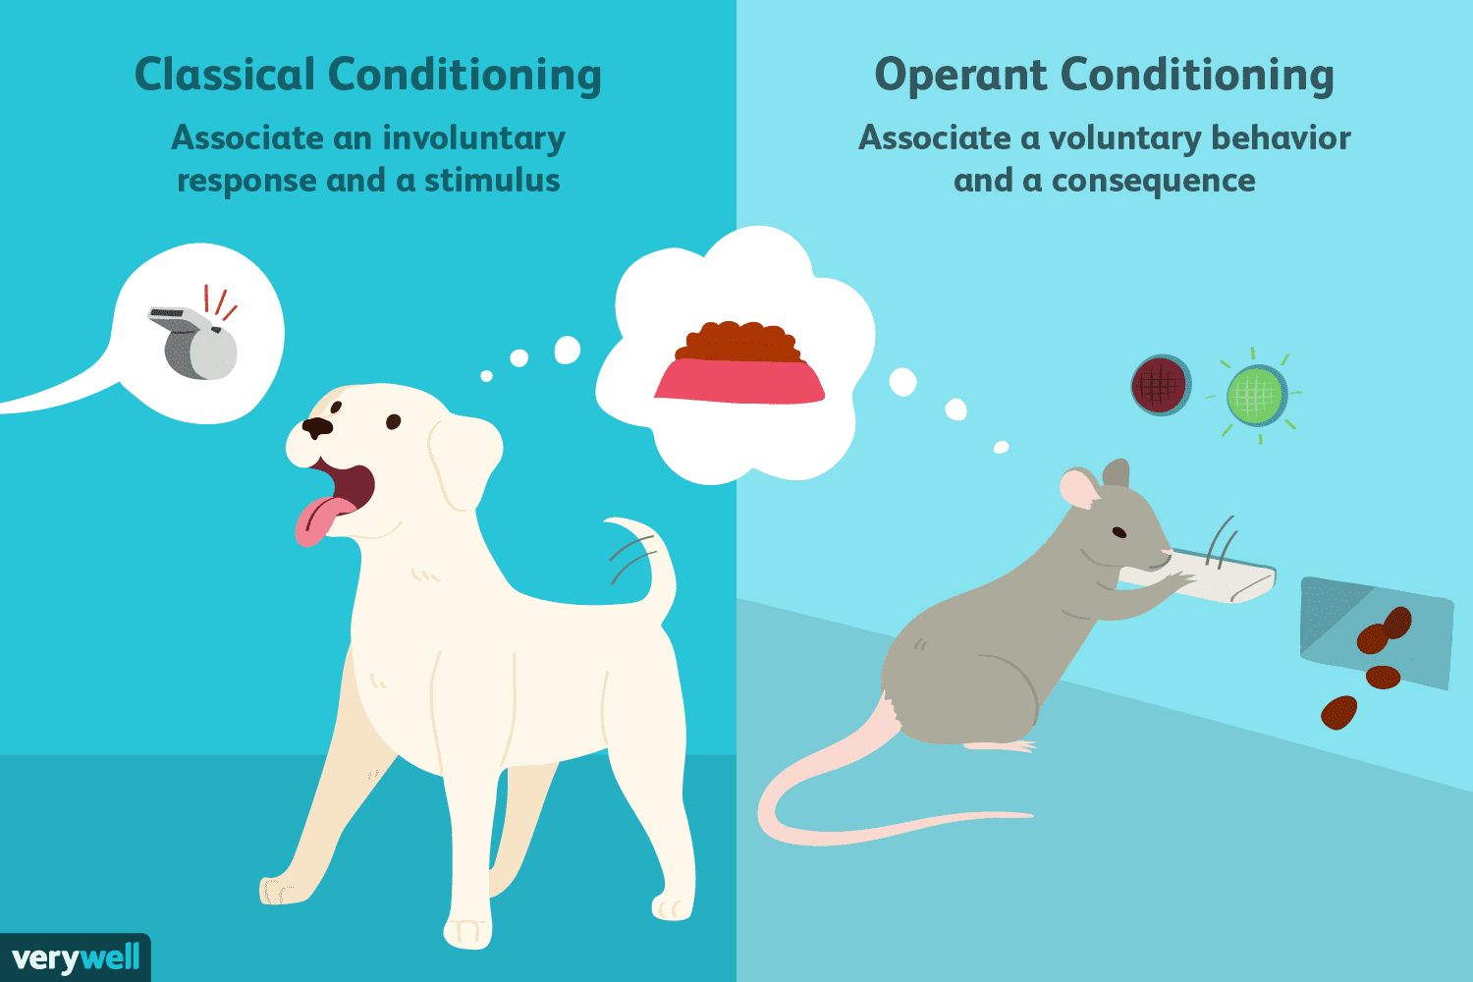
Brains and Reinforcement Learning
Two Families of Learning Problems
Classical conditioning: stimulus → outcome
Instrumental/operant conditioning: action → outcome
Both shape behavior in different ways
Notes:
Reinforcement learning connects most directly to what psychologists call instrumental, or operant, conditioning.
But to see the contrast clearly, it helps to place it alongside classical conditioning.
In classical conditioning, the problem is to learn which stimuli predict important events.
A tone predicts a shock, or a logo predicts tasty food.
The animal or person learns stimulus–outcome associations.
In instrumental conditioning, the problem is to learn which actions bring about good or bad outcomes.
Pressing a lever leads to food, or touching a hot stove leads to pain.
The animal or person learns action–outcome associations.
Both forms of learning are important and both shape behavior, but instrumental conditioning introduces the idea of voluntary action, consequences, and trial-and-error reinforcement.
That is what pushes us toward the computational challenges of reinforcement learning.

Slide 13
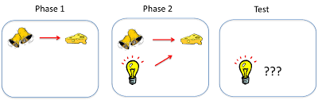
Brains and Reinforcement Learning
Prediction Matters
Blocking shows limits of pairing
Learning depends on surprise
Prediction error drives updates
Notes:
One of the clearest demonstrations of the limits of simple pairing is called blocking.
Suppose a rat first learns that a tone predicts food.
Later you add a light alongside the tone, and still deliver food.
Even though the light is paired with the food, the rat never learns to respond to the light.
The reason is that the food is no longer surprising.
The tone already predicts it perfectly, so the light adds no new information.
This shows us that learning depends not just on pairings, but on prediction and surprise.
The key signal is the prediction error —
the difference between what is expected and what actually happens.
As we’ll see in upcoming lectures, prediction by itself is not enough.
What truly drives learning is the error between prediction and reality,
and that error signal is what reinforcement learning mechanisms are designed to use.

Slide 14
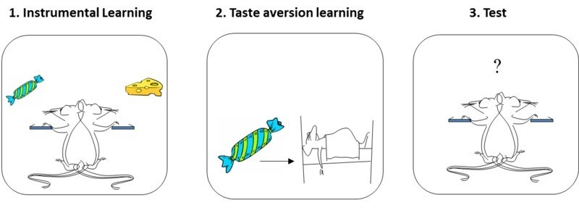
Brains and Reinforcement Learning
Goals Matter
Reinforcer devaluation
Actions change when outcomes lose value
Evidence for goal-directed control
Notes:
Another important clue comes from what psychologists call the reinforcer devaluation effect.
Imagine you train a rat to press a lever for food pellets.
At first, it presses eagerly, because the pellets are rewarding.
Now suppose you make the pellets undesirable —
maybe by pairing them with a chemical that causes nausea.
When you return the rat to the lever, it presses much less.
It has learned not just that pressing leads to pellets, but that the value of those pellets matters.
This shows that animals are not only stamping in habits.
They can adjust their actions when the goals change.
Reinforcement learning has to be sensitive to the current value of outcomes, not just their past history.
That distinction — between goal-directed actions and automatic habits —
will become central as we keep building the story.

Slide 15
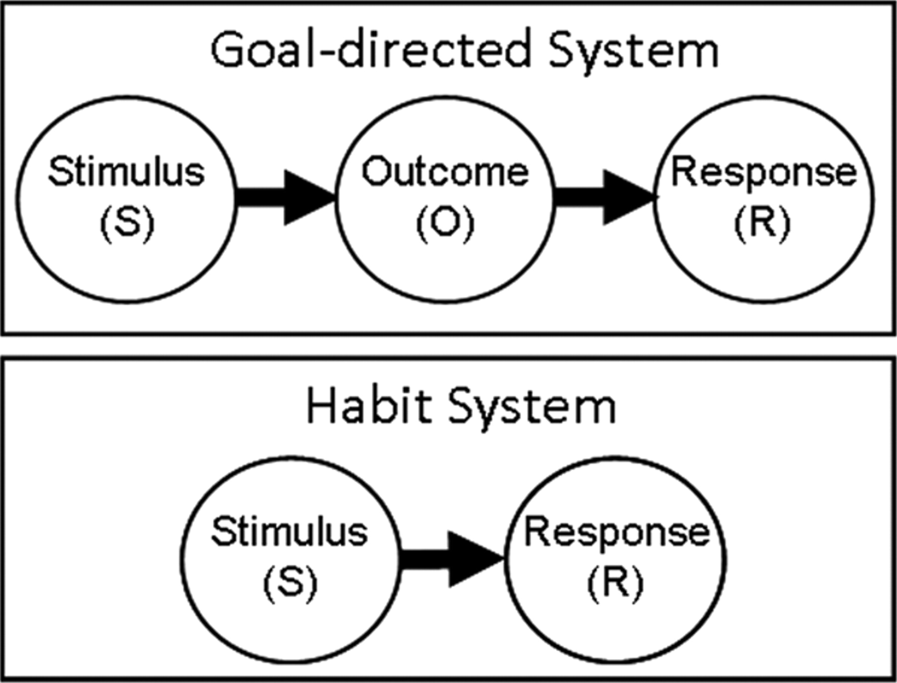
Brains and Reinforcement Learning
Habits vs Goal-Directed Control
Goal-directed: sensitive to outcomes
Habits: automatic, outcome-insensitive
Both emerge through reinforcement
Notes:
With enough practice, actions that start out as goal-directed can become habits.
At first, pressing a lever depends on the value of the food.
But after extensive repetition, the animal will keep pressing even if the food has been devalued.
This tells us there are two modes of behavioral control.
In goal-directed control, actions are chosen based on their predicted outcomes.
In habits, actions are triggered more automatically by cues and past reinforcement, even if the outcome no longer matters.
Both modes rely on reinforcement learning.
Goal-directed control shows flexibility, while habits provide efficiency and speed.
The computational challenge is to explain how both emerge from the same underlying system of reinforcement.

Slide 16
Brains and Reinforcement Learning
 |  | Expected
 |  | Good | Bad
Actual | Good | Satisfaction | Relief
 | Bad | Disappointment | Resignation
Relief and Disappointment
Learning from what doesn’t happen
Relief: expected bad outcome omitted
Disappointment: expected good outcome omitted
Notes:
Reinforcement learning isn’t just about outcomes — it’s about how outcomes compare to what was expected.
We can think of this in a simple 2×2 grid,
with expected outcomes on one side and actual outcomes on the other.
If you expect something good and you get something good, that’s satisfaction.
If you expect something bad and you get something bad, that’s resignation.
In both of those cases, nothing changes — there’s no prediction error.
But the off-diagonal cells are where learning happens.
If you expect something bad and instead something good happens, that’s relief.
If you expect something good and instead something bad happens, that’s disappointment.
Both relief and disappointment are powerful teaching signals.
They show that the brain isn’t only coding for what happens,
but also for what fails to happen.
And this ability to learn from mismatches between expectations
and reality is a hallmark of reinforcement learning.

Slide 17
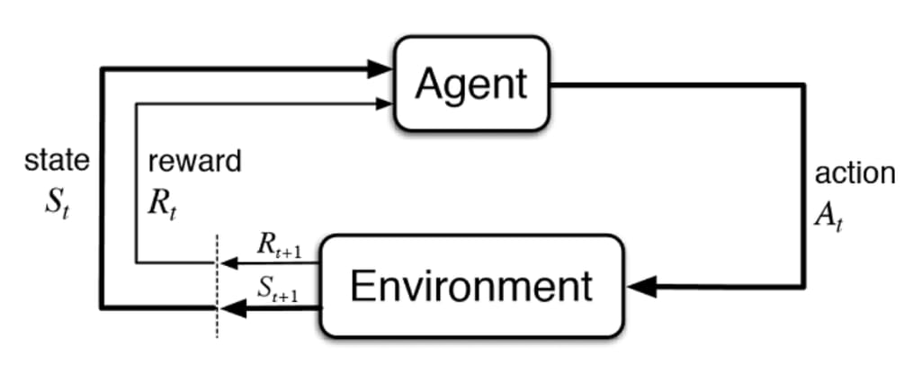
Brains and Reinforcement Learning
Computational Definition of Reinforcement Learning
Choose actions over time
Maximize expected cumulative reward
Solve credit assignment across delays
Notes:
We can now pull these pieces together into a simple definition.
Reinforcement learning is about choosing actions over time to maximize expected long-term outcomes.
That means more than just pairing stimuli.
It means tracking which actions improve or worsen future states, and adjusting behavior accordingly.
The technical challenge is credit assignment:
deciding which steps in a sequence should be reinforced when outcomes arrive later.
We’ve seen evidence for this in blocking, where predictions matter,
in reinforcer devaluation, where goals matter, and in the shift from goal-directed control to habits.
All of these point to the need for a system that evaluates actions by their consequences,
even when those consequences are delayed.
And as we’ll see in the next lecture, this wasn’t just a puzzle for biologists and psychologists.
It turned out to be the exact same stumbling block for early artificial intelligence systems,
including Marvin Minsky’s first attempts at machine reinforcement learning.

Slide 18
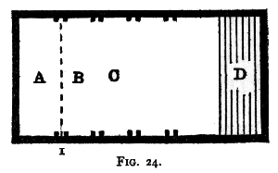
Brains and Reinforcement Learning
Minimal Evolutionary Requirement
Trial-and-error sequences
Flexible responses, not just reflexes
Fish succeed, worms fail
Notes:
At a minimum, reinforcement learning gives an animal the ability to chain together arbitrary actions
through trial and error.
That’s very different from a reflex, which is fixed, or from Hebbian association,
which only links things that occur together in time.
Fish are a good example of the leap this makes possible.
They can learn to escape through hidden openings, to push buttons for food, or to jump through hoops
— and they can remember these behaviors for months.
They are able to explore, discover which actions work,
and refine their sequences based on outcomes.
By contrast, simple worms and other bilaterians cannot learn arbitrary action sequences.
They can steer and react, but they cannot flexibly discover new chains of behavior that lead to reward.
So the evolutionary requirement was clear.
In a Cambrian world of predators and competition,
only animals with reinforcement learning could adapt in flexible, creative ways.

Slide 19
Brains and Reinforcement Learning
What We Learned / What’s Next
RL = actions linked to delayed outcomes
Requires prediction error and goal sensitivity
Next: why early AI also struggled with this
Notes:
Today we framed reinforcement learning at the computational level.
We saw that Hebbian association is powerful, but it cannot handle delayed consequences.
Reinforcement learning solves this by assigning credit to the right actions across time.
We looked at blocking, which shows that prediction error is essential,
and at reinforcer devaluation, which shows that current goals matter.
We also saw the difference between goal-directed actions and habits,
and why both must be supported by a learning system.
Finally, we placed this in an evolutionary context,
where animals like fish could learn arbitrary action sequences,
but simple worms could not.
So the computational problem is clear: connect actions to delayed outcomes,
using prediction and current value to guide behavior.
But as we’ll see in the next lecture, this problem is not unique to biology.
Early artificial intelligence researchers tried to make machines learn
from rewards and ran into the exact same obstacle.
Next time we’ll see why Marvin Minsky’s first reinforcement learning machine failed,
and how that failure set the stage
for the modern solutions that brains and AI algorithms actually use.

